Slide 1
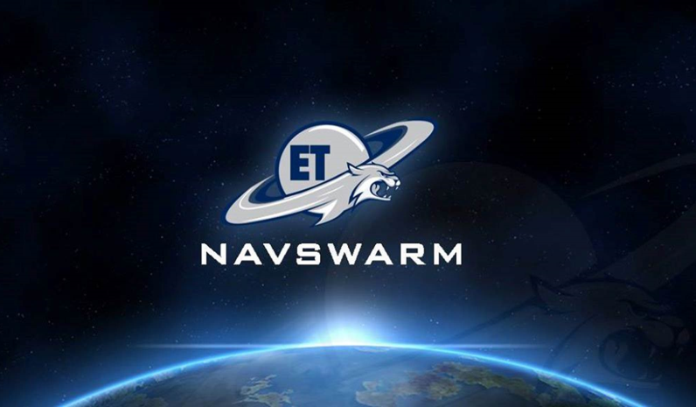

Slide 2



Overview
Project Statement
Design Constraints
Alternate Bot Design
New Bot Design
Decision Matrix
PSO
Controls
Arduino to Pi
GPS
IMU
XBee to XBee
Barometer
Cost Analysis
Project Timeline
Project Outlook

Slide 3
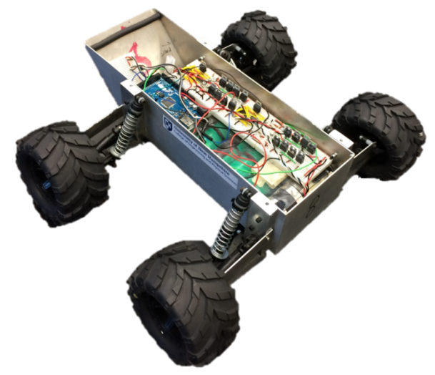
Project Statement
Our goal is to create fully autonomous robots to act as a test platform for the Particle Swarm Optimization (PSO) algorithm. In order to do this, we update the current fleet and create ten new robots that improve on previous designs. To prove that our test platform is compatible with PSO we will search for the highest point in Boulder Field.

Slide 4
Design Constraints
Must be fully autonomous.
Must be able to run in all seasons.
Must be able to traverse rough and unpredictable terrain.
Must be able to integrate with PSO.

Slide 5
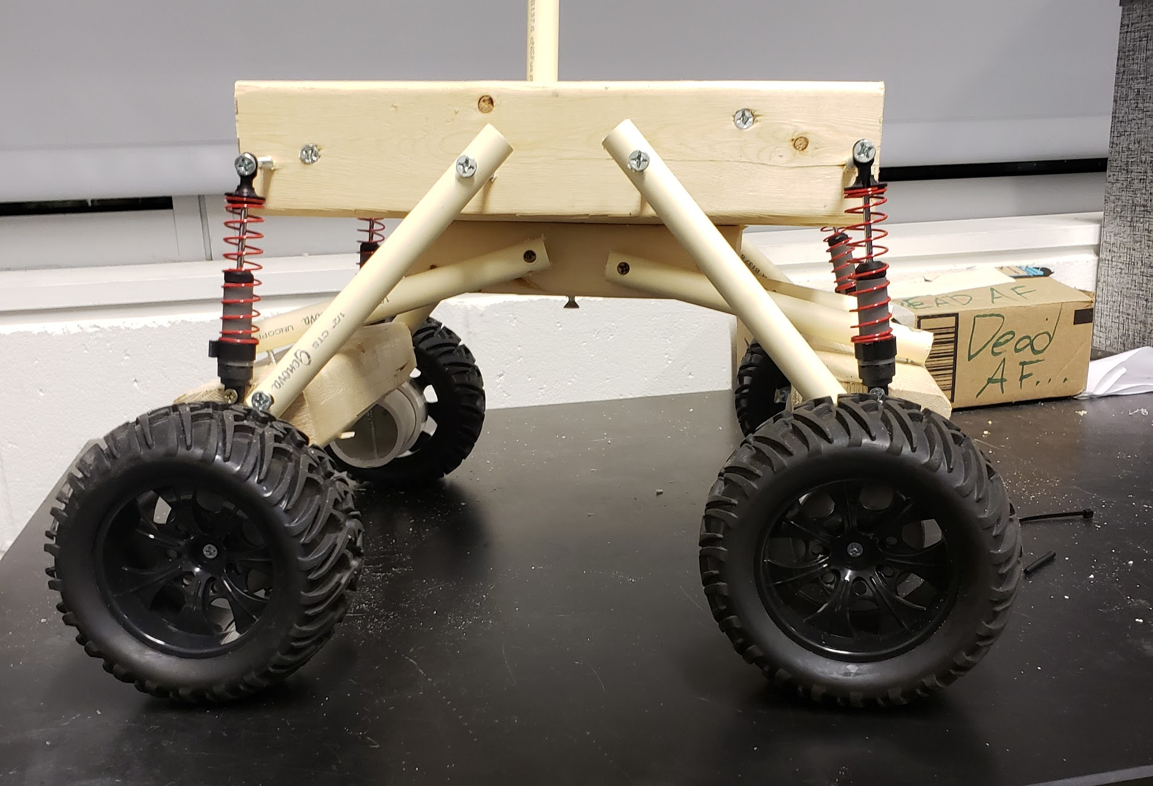
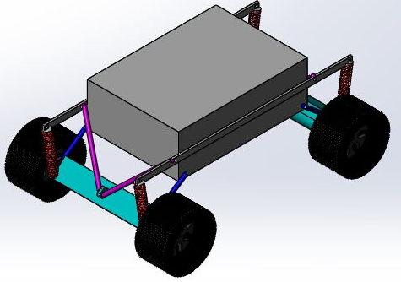
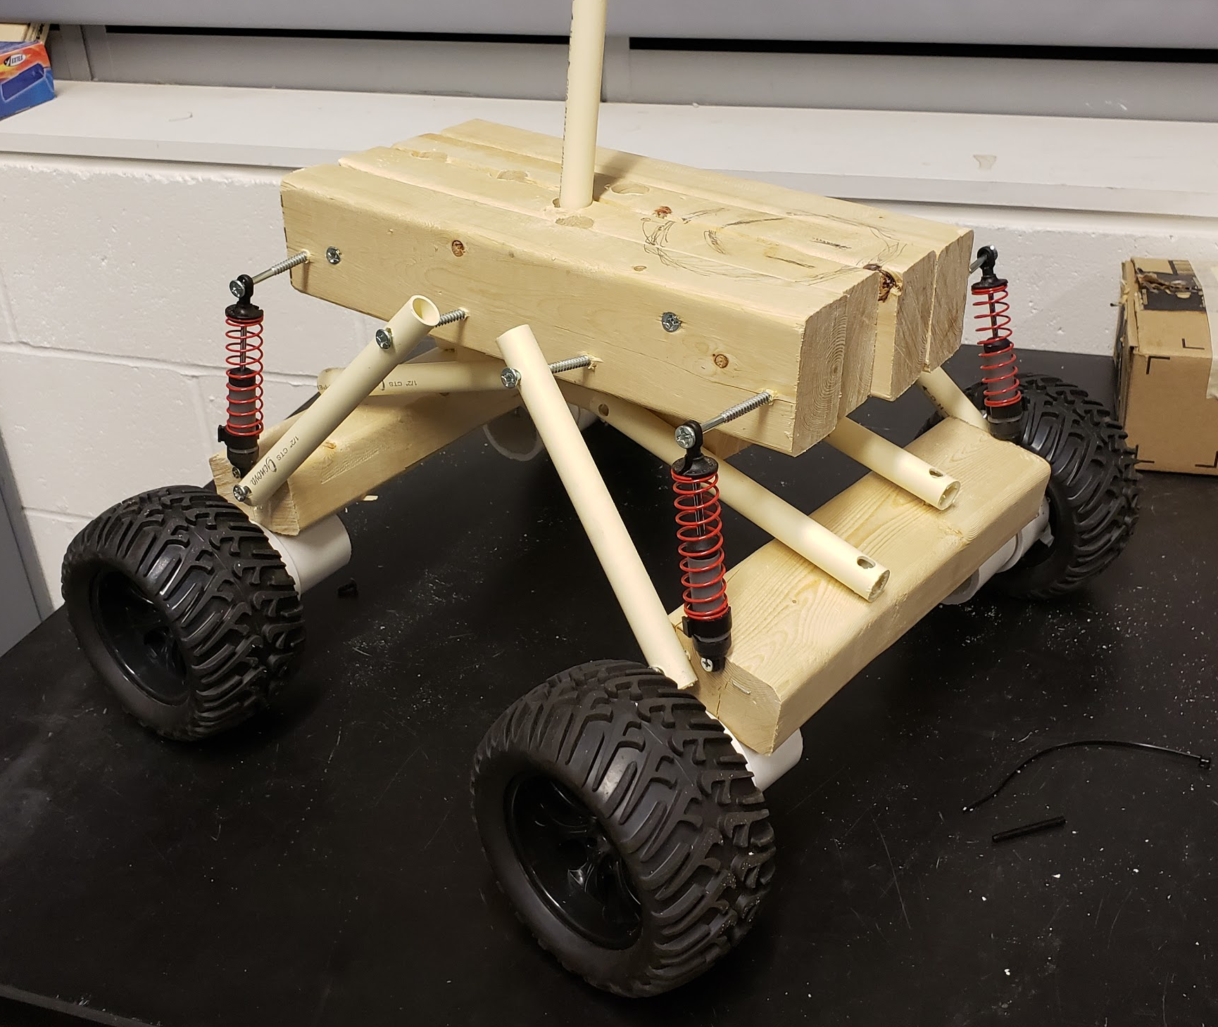
Alternate Bot Design (Rock Crawler)
Alternate design modeled after a 1/10 scale RC Rock Crawler.
Utilizes Springs, dampers, which must be calibrated.
Designed from readily available pre-fabricated parts, allowing the parts to simply be purchased and installed.
While it can tackle rough terrain, the chassis experiences greater vibrations than the Rocker Bogie Design

Slide 6
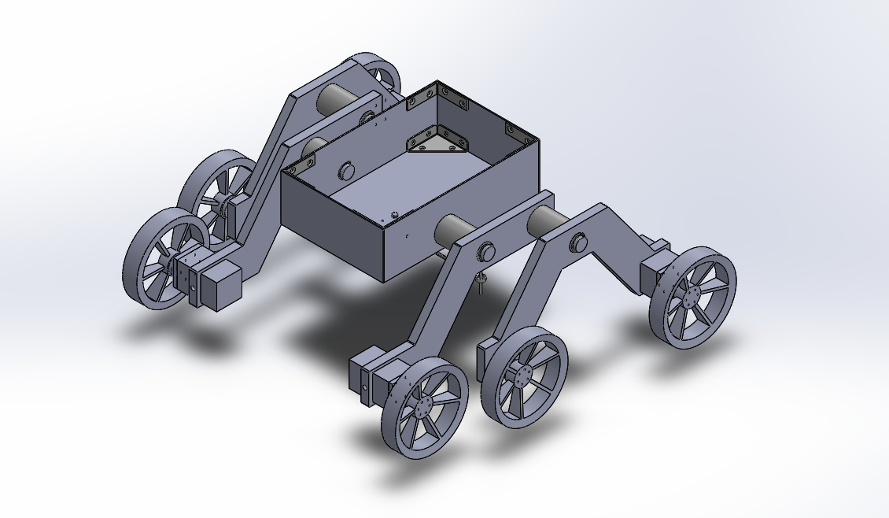
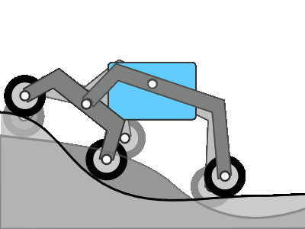
New Bot Design (Rocker Bogie)
Inspired from NASA’s Curiosity rover. Uses under mounted differential bar.
Allows for very versatile terrains.
Removes need for springs and dampers.
HDPE frame and suspension for reduced cost and easier manufacturing. Minimal machining and weld free design.
Easy construction.
Water resistant motor housings.

Slide 7
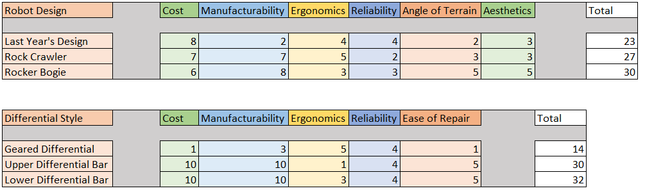
Decision Matrix
Cost and Manufacturability are weighted more heavily since we are on a limited budget, and have limited time to build.

Slide 8
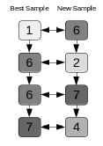
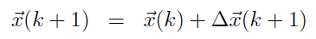
PSO
Requires Pressure and GPS data as input
Xbee for interbot communication
Outputs new location within search space
Now programming

Slide 9
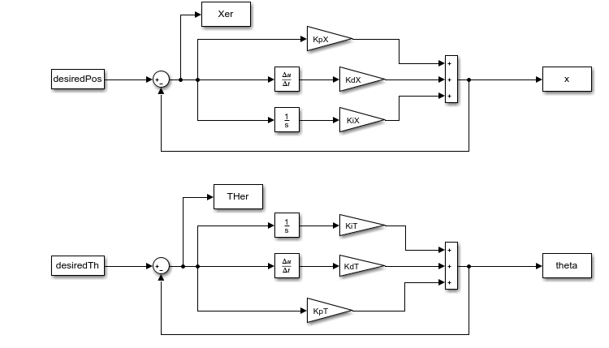
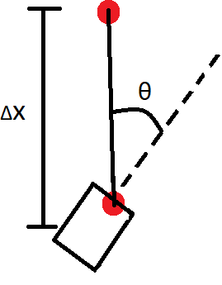
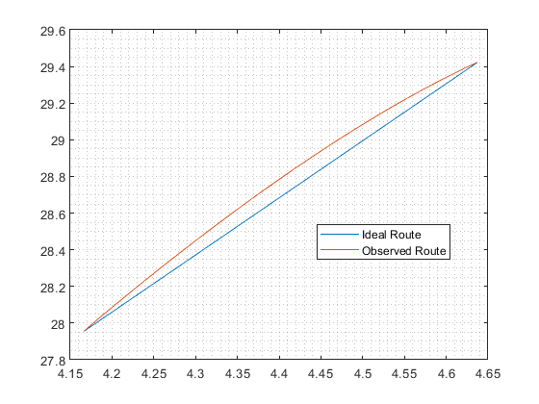
Controls
Using the new “x” value and “theta” value the new position of the bot can be calculated and fed back through the controller and to recalculate the new position

Slide 10
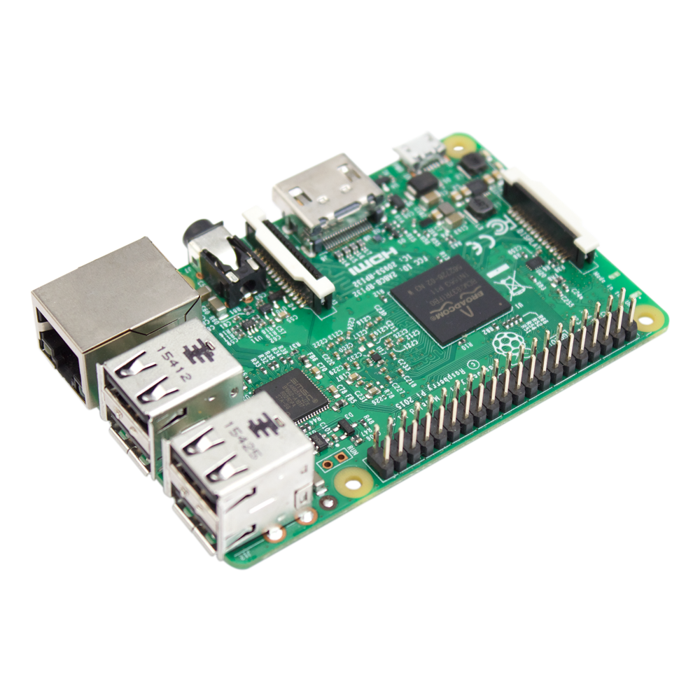
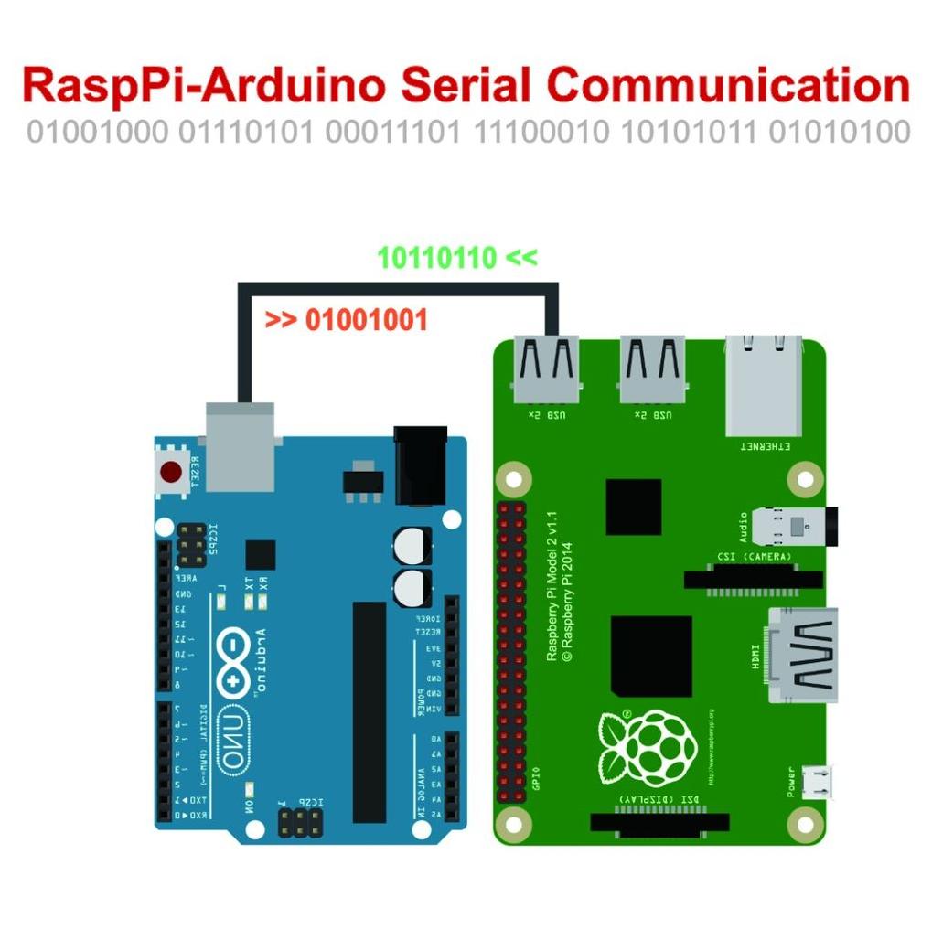
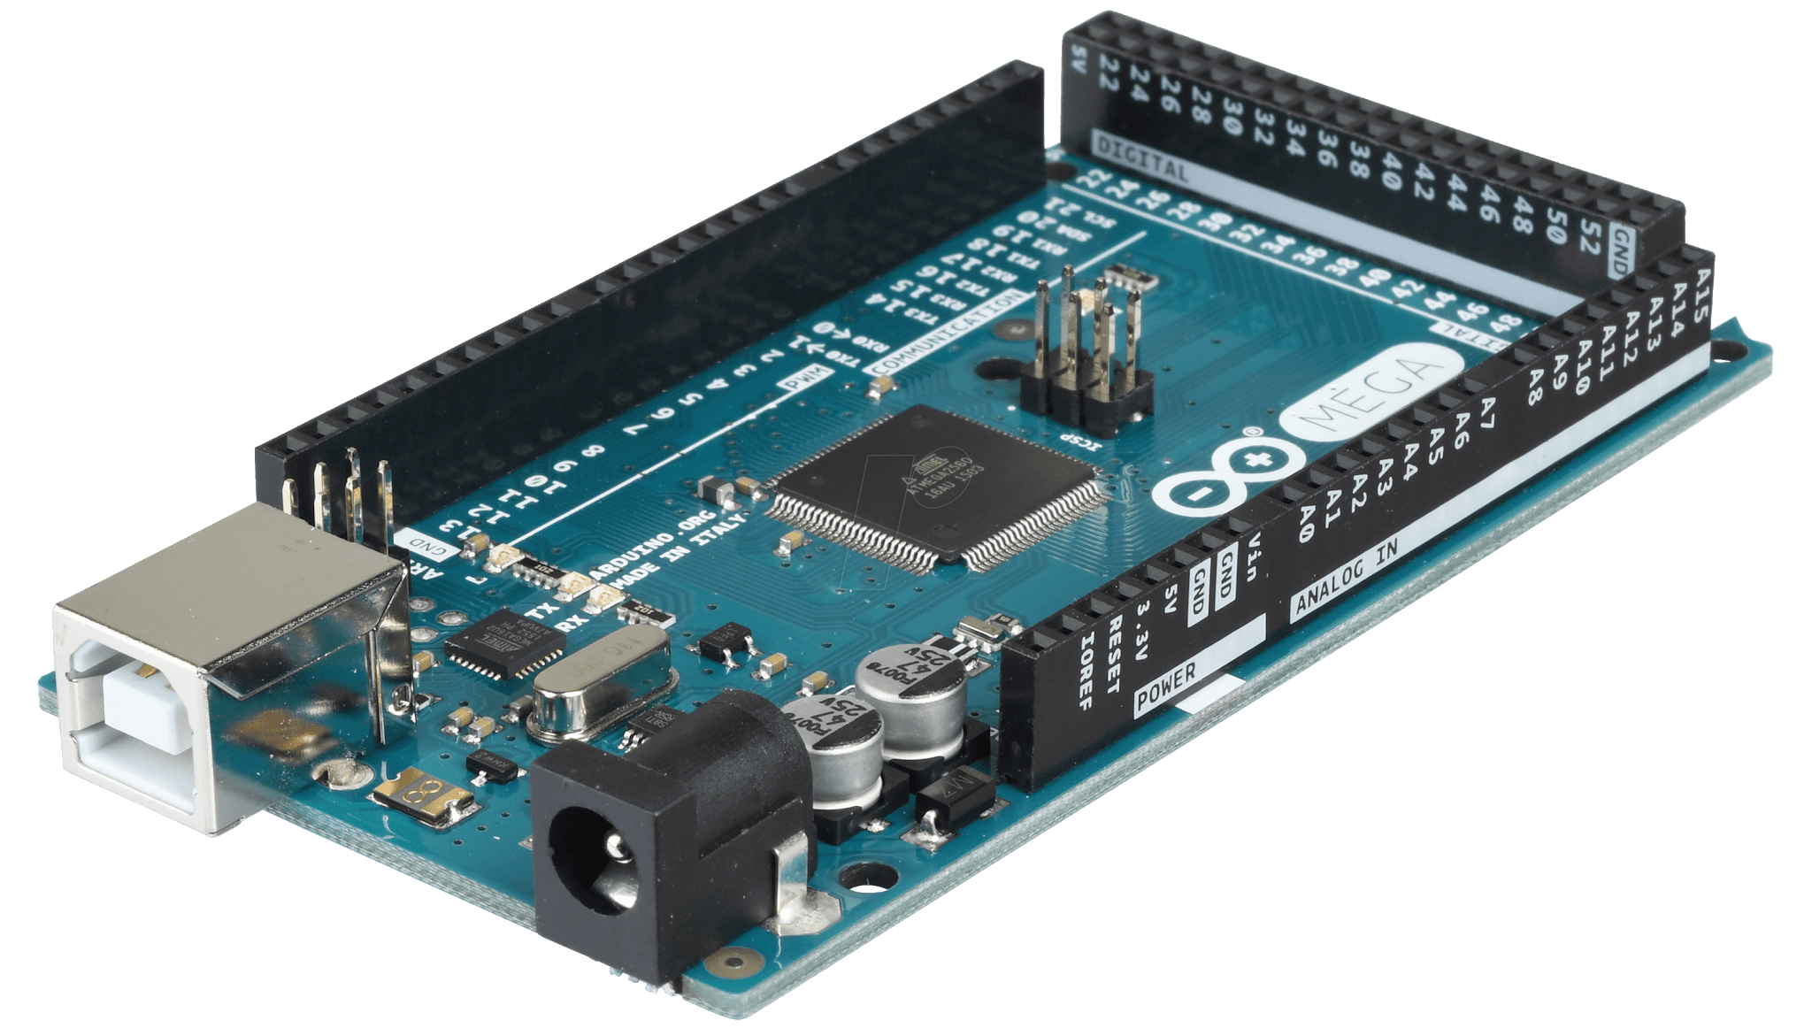
Arduino to Pi
The NavSwarm bots use both an Arduino as well as a Raspberry Pi
Although communication between the two is a very fragile part of the bot’s infrastructure, we have successfully established it, and is currently in full working order

Slide 11
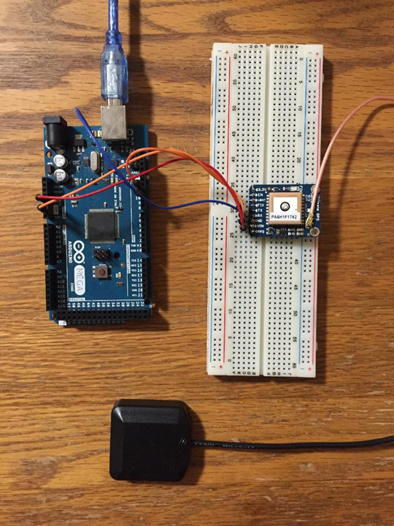
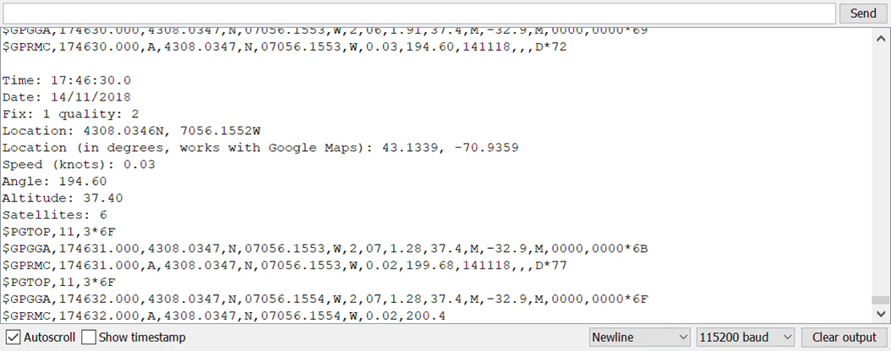
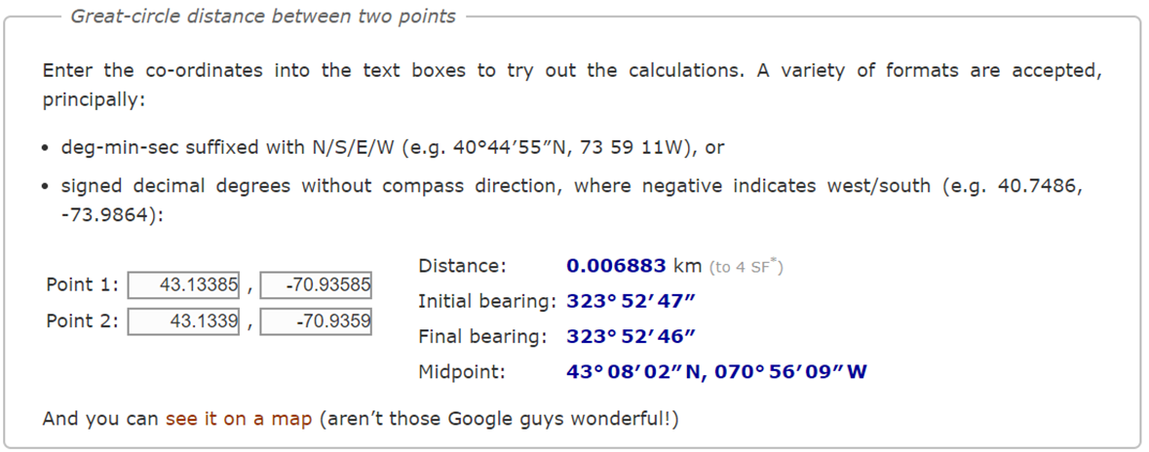
GPS
Used to help the PSO determine when a bot reaches it’s given destination.
The higher the accuracy of the GPS, the more precise our algorithm can be, but this can be costly.

Slide 12
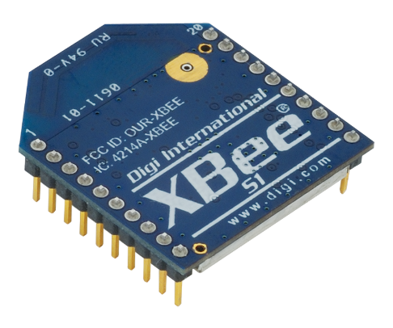
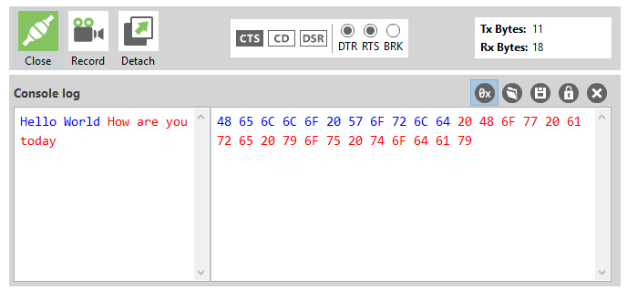
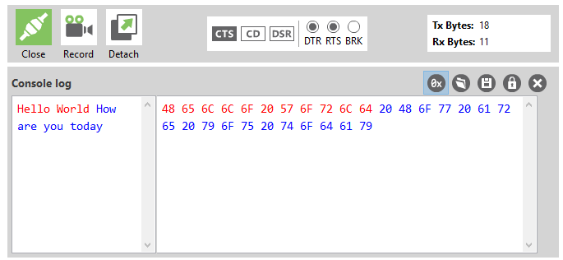
XBee to XBee
XBee to XBee radio communication allows Bots to communicate and share information.
XBees successfully communicate in XCTU
Working to integrate legacy design and code, though have encountered difficulties
Currently trying establish communication from XCTU (PC) to Raspberry Pi

Slide 13
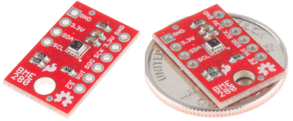
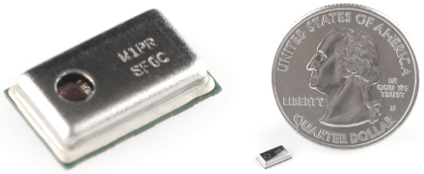
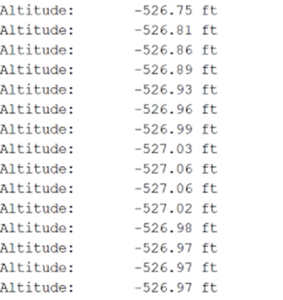
Barometer
Measures the altitude of the bots allowing them to determine the highest point in a given field, through the use of the PSO algorithm
Supplies accurate data relative to itself, which will work for our end goal
But is not properly calibrated to determine the actual altitude
Currently only have one pressure sensor so will have to buy a large amount of them, at least one per bot
$19.95
$5.95
This is the sample sensor we currently have
Plausible option if we print our own circuit board, which we want to do

Slide 14
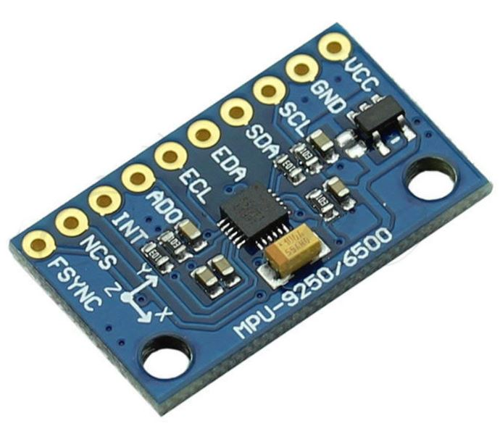
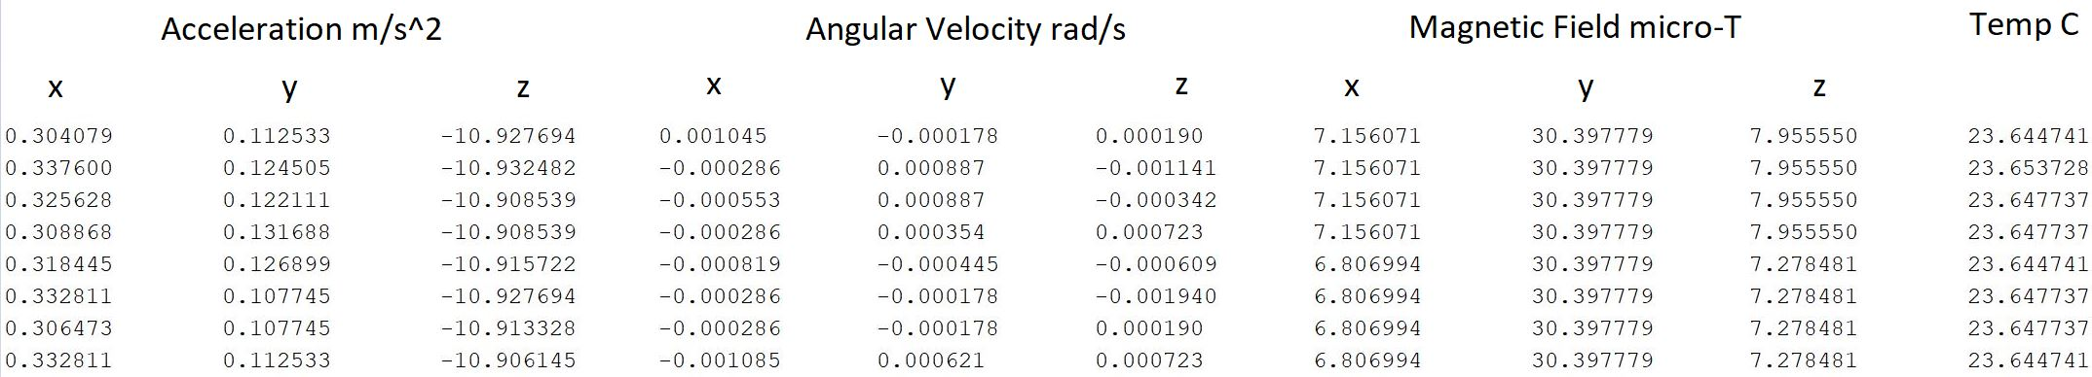
Inertial Measurement Unit
MPU-9250 9-axis Motion Processing Unit
Purpose: Used to determine a bots 3D orientation in space, which is essential for navigation
Successfully obtained all sensor outputs
Currently working on calculations for the roll, pitch and yaw angles

Slide 15
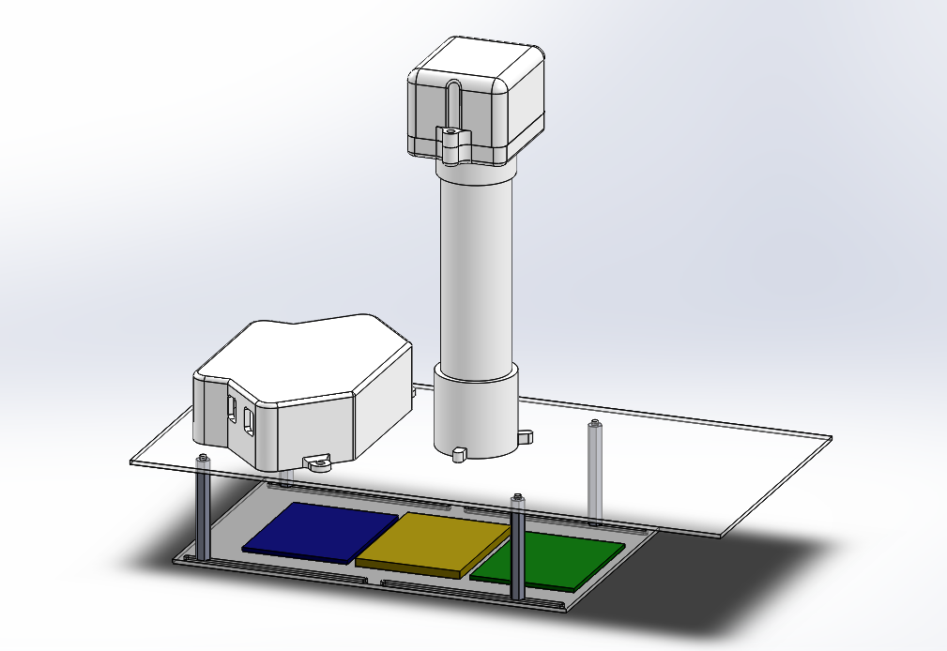
Modularity
Objective: Create a simple design to keep all components together and allow for transitions from one chassis to another.
Cost Effective
Easily Manufactured
Minimal disassembly required to change chassis

Slide 16
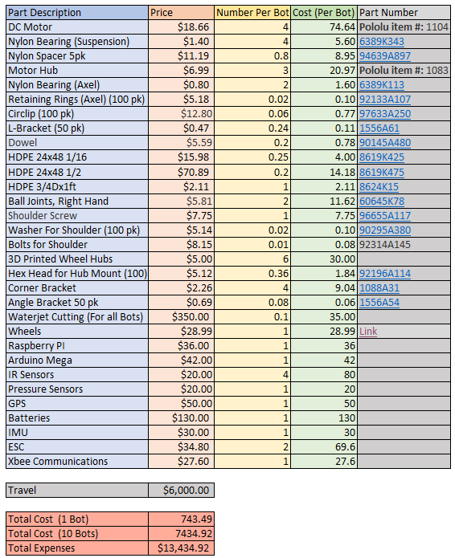
Cost Analysis
With our electrical equipment not changing, the only room for cost improvement is by redesigning the suspension and the chassis.
By using the new design we estimate that each bot will be almost $250.00 less than the previous iteration.
This number is subject to change as problems arise and equipment like the GPS is changed.

Slide 17
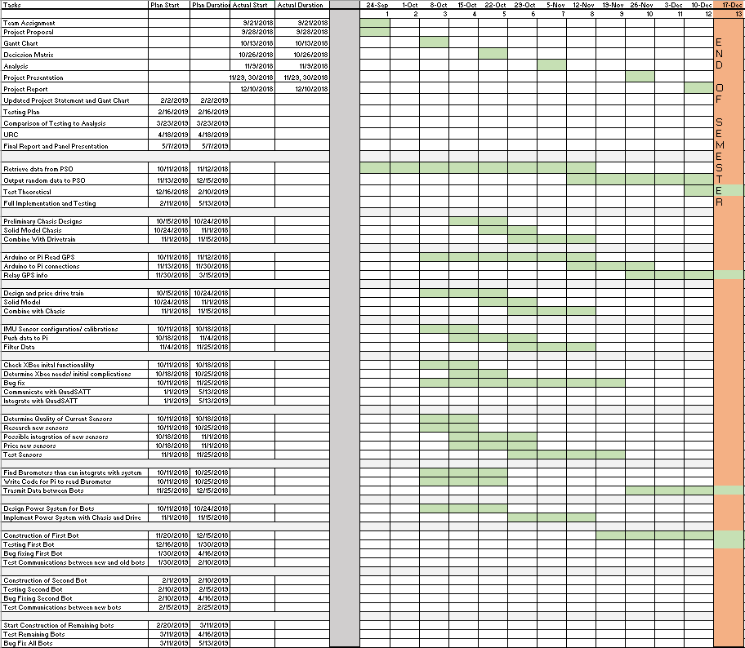

Slide 18
Project Timeline
In short, we are about 2 weeks behind schedule.
We struggle to
A team of Starting construction of the robots in the middle of November was overly ambitious. The modeling is 99% complete, with minor tweaks being made as it is getting ready for machining. The robot was designed with easy assembly in mind, so assembly time will hopefully be short.

Slide 19
Project Outlook
What to look forward to
First bot assembled during or shortly after winter break. After initial testing the rest of the fleet can be rapidly assembled.
Implementation of PCB’s.
New PI control system.
XBee to XBee communications.
Implementation of PSO.

Slide 20
Questions?
Rock Crawler- Brian Brophy, Alex Cerce
Rocker Bogie- Shaun Kerr, Brian Mitchell
Arduino to Pi- Kevin Shea
GPS- Tim Russell
IMU- Tristan Lee
XBee to XBee- Jacob Shaker
Barometer- Alex Nees
PSO-Tuller Schricker
Controls- Brian Mitchell
Modularity- Ben Stadnicki

